Slide 1

SEarch
ANU YADAV

Slide 2
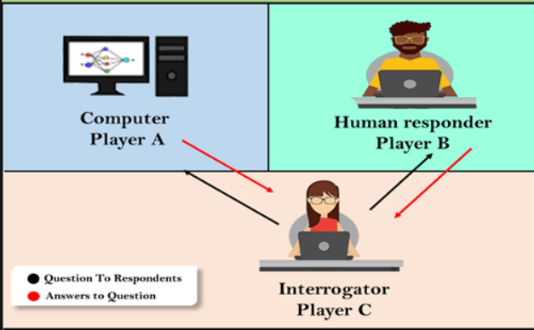
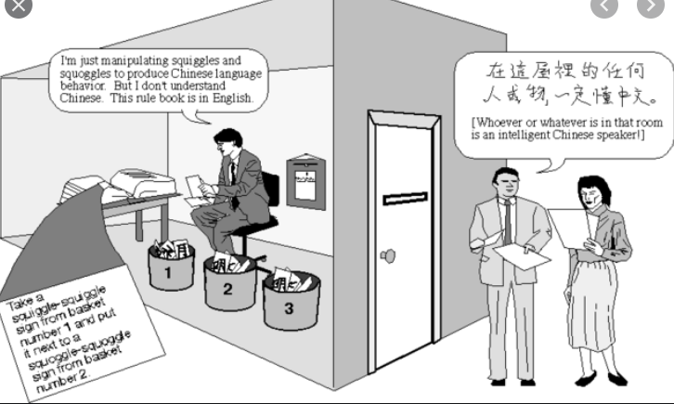
INFORMED SEARCH

Slide 3
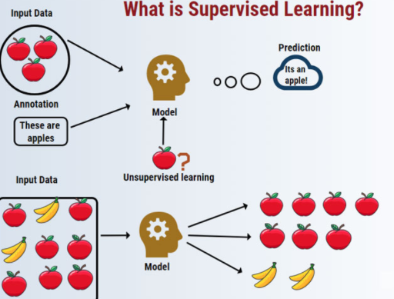

Slide 4
INFORMED SEARCH
TWO FACTORS : Heuristic search and heuristic function.
Information about GOAL state is present.
It is Better than uninformed search
It is used to find optimal solution (using heuristic function -> minimum path cost) to reach GOAL state.
It is a search which tries to reduce amount of search that must be done by making intelligent choices for the nodes that are selected foe expansion
EG: A* Search Algorithm, Best fit Search Algo

Slide 5
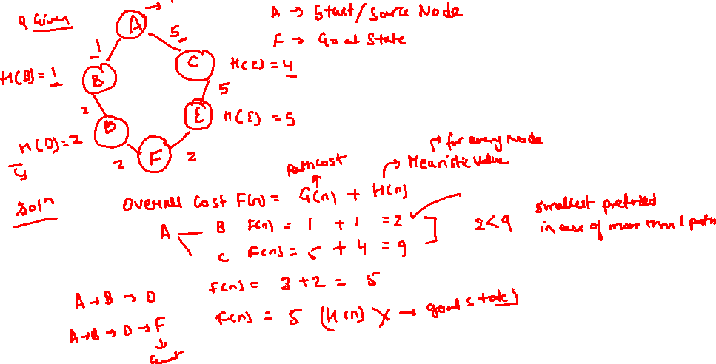

Slide 6
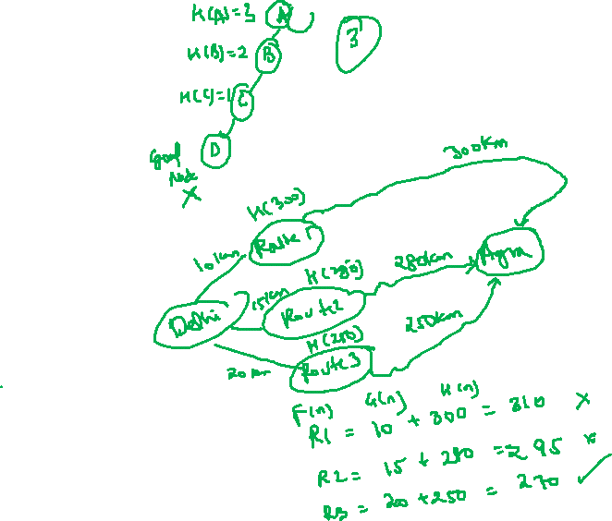
HEURISTIC SEARCH
HEURISTIC SEARCH: It tries to optimize a problem using heuristic function [Informed search]. It tries to solve problem in minimum cost or steps
HEURISTIC Function: H (n), that gives an estimation on cost of getting from root node n to Goal node/ state.
Help in selecting optima node foe expansion.
It is used for estimated values.

Slide 7
TYPES OF HEURISTIC
Admissible: Under estimation, in this heuristic function never overestimate the cost of reaching the Goal state. H(n) is always less than or equal to actual cost of lowest path from node N to goal state node.
H(n) <= H’(n) [goal]
Non Admissible: OVER ESTIMATE, H(n) is always more than to actual cost of lowest path from node N to goal state node. H(n) > H’(n)

Slide 8
